Slide 1
Websy at Dinner Time
By Nathan Smith

Slide 2
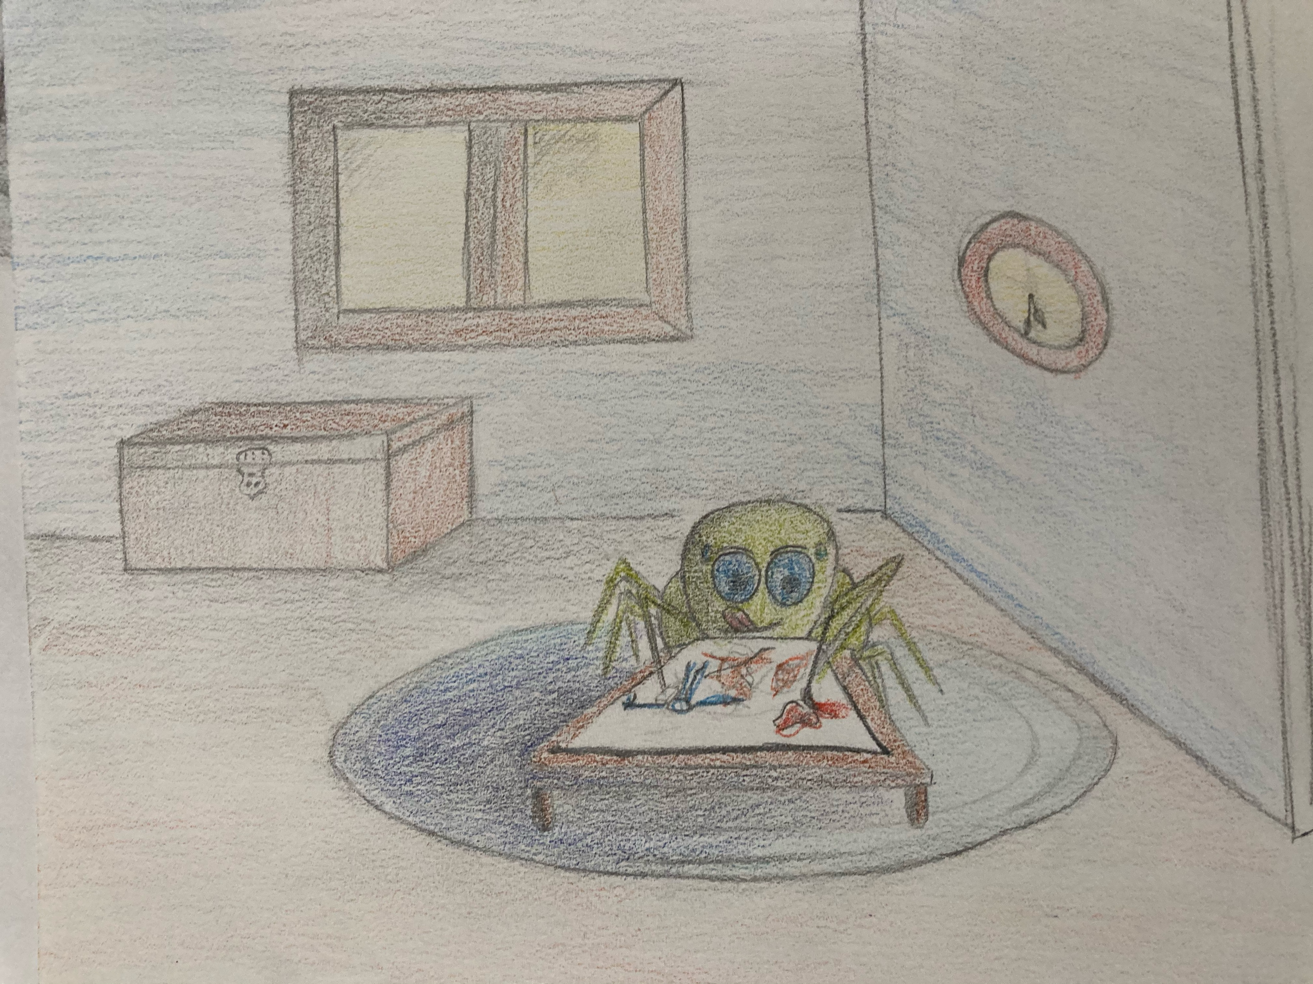
Time for dinner, Websy!
Little Websy is
working away on his pretty art. It's about time for dinner when his daddy calls him in to eat.

Slide 3
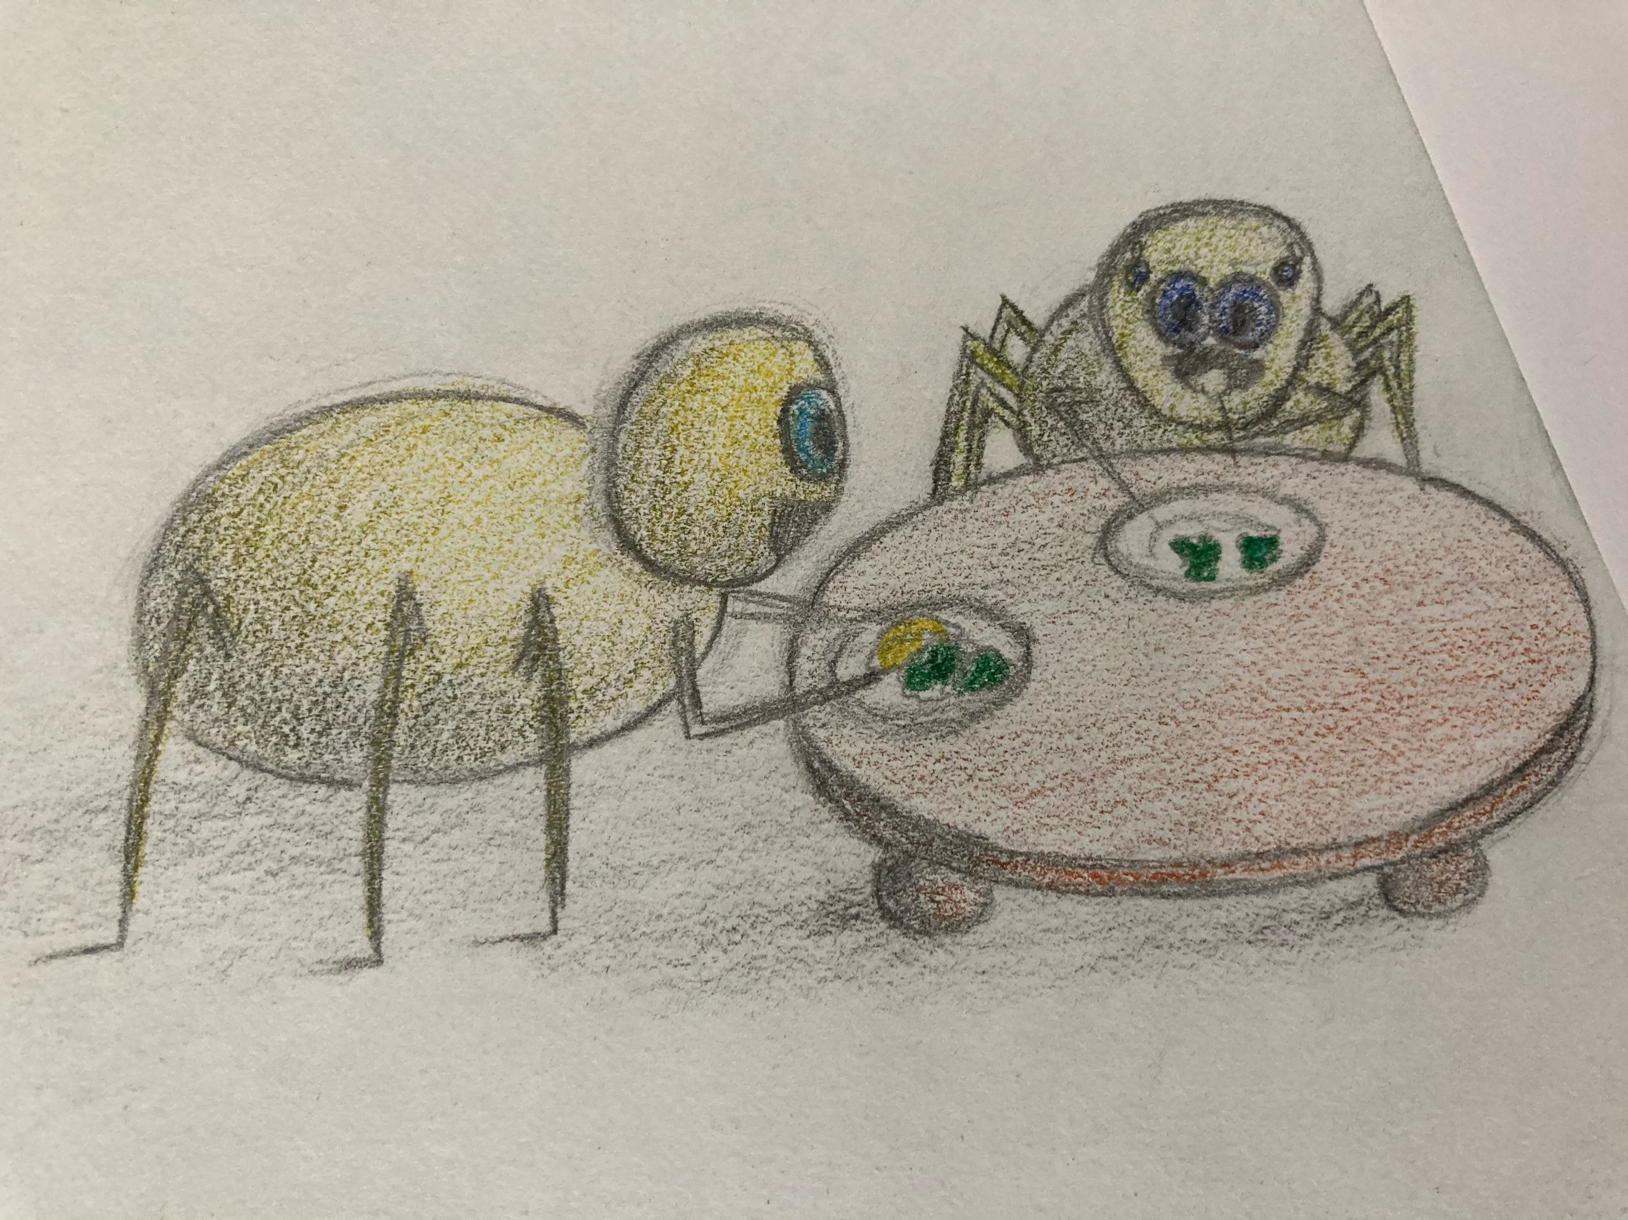
You need to eat your broccoli now, mister.
No, it is gross!
Daddy isn't paying attention and Websy chows down on all of his mac n' cheese. Finally, Daddy notices and says...

Slide 4
You don't get any more mac n' cheese until you eat your broccoli
But I don't want to eat it!

Slide 5
They are healthy for you, and you need to.
NO!

Slide 6
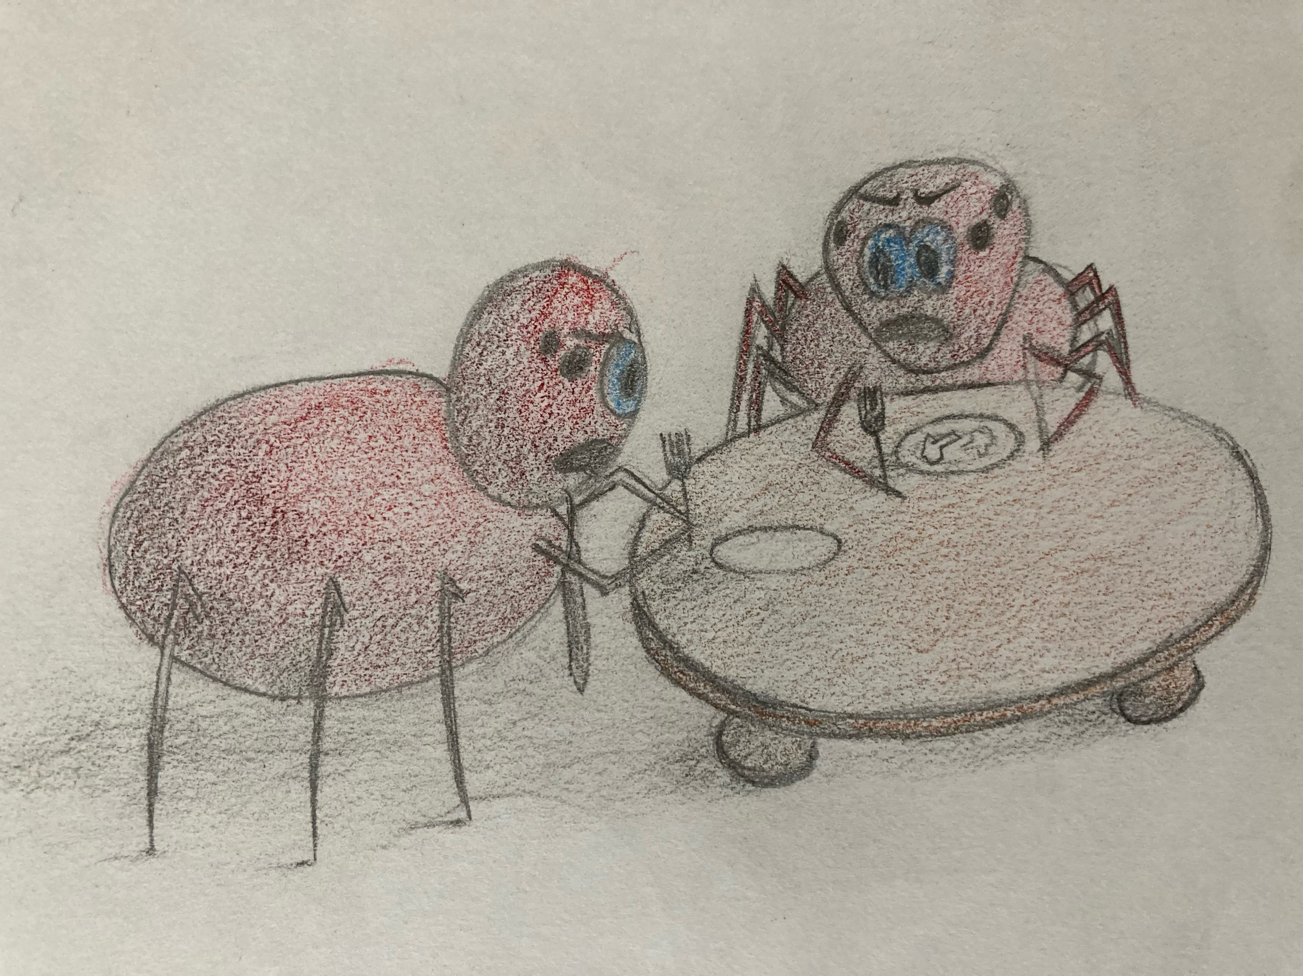
NO, NO, NO!
YES!
It has been a long day for Daddy, and Websy is a bit cranky. Their emotions start to get the best of them, and they take it out on each other. They both start to get very upset.

Slide 7
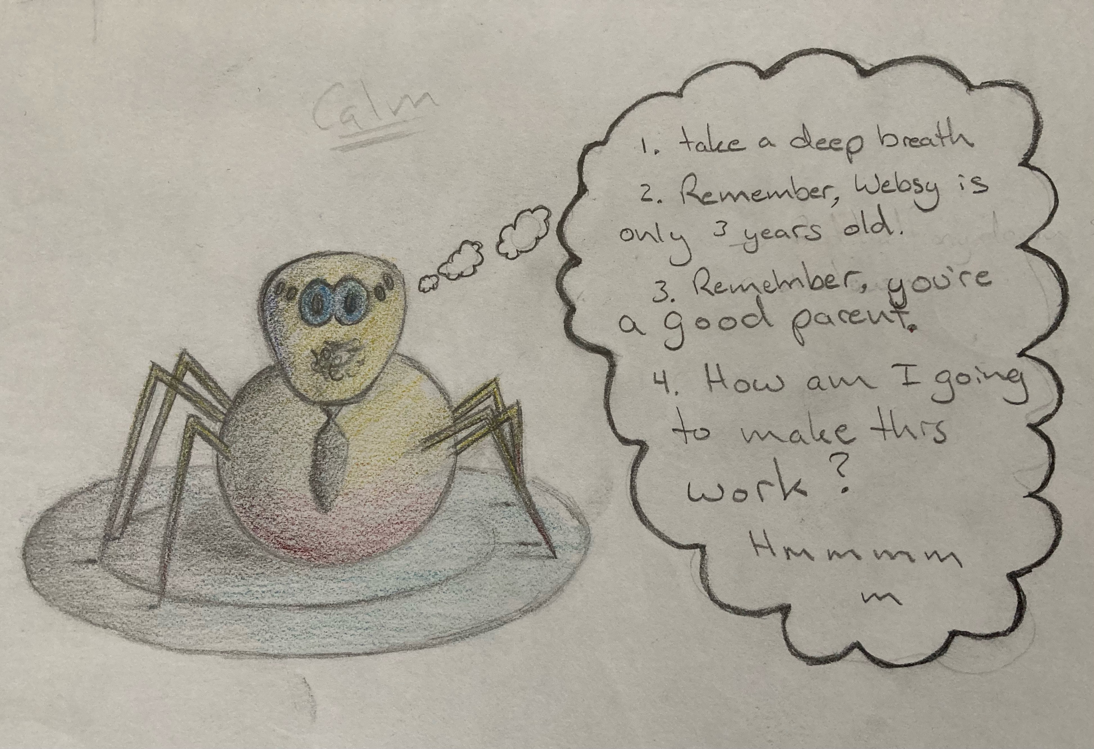
Daddy realizes he let things get out of control. He leaves the room to calm down.

Slide 8
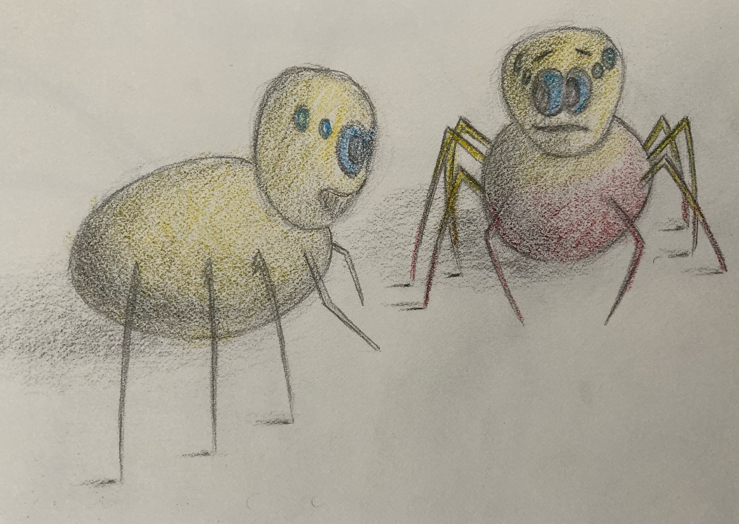
Let's both take a few deep breaths together to calm down. We'll breathe in for 3 seconds, hold for 3 seconds and breathe out for 3 seconds.
Now that Daddy is calm, he helps websy get calm. You can see the red anger slowly going away as they talk. Websy starts to cool off as Daddy talks to him. They could do breathing exercises, talk, or hug. What would you do?

Slide 9
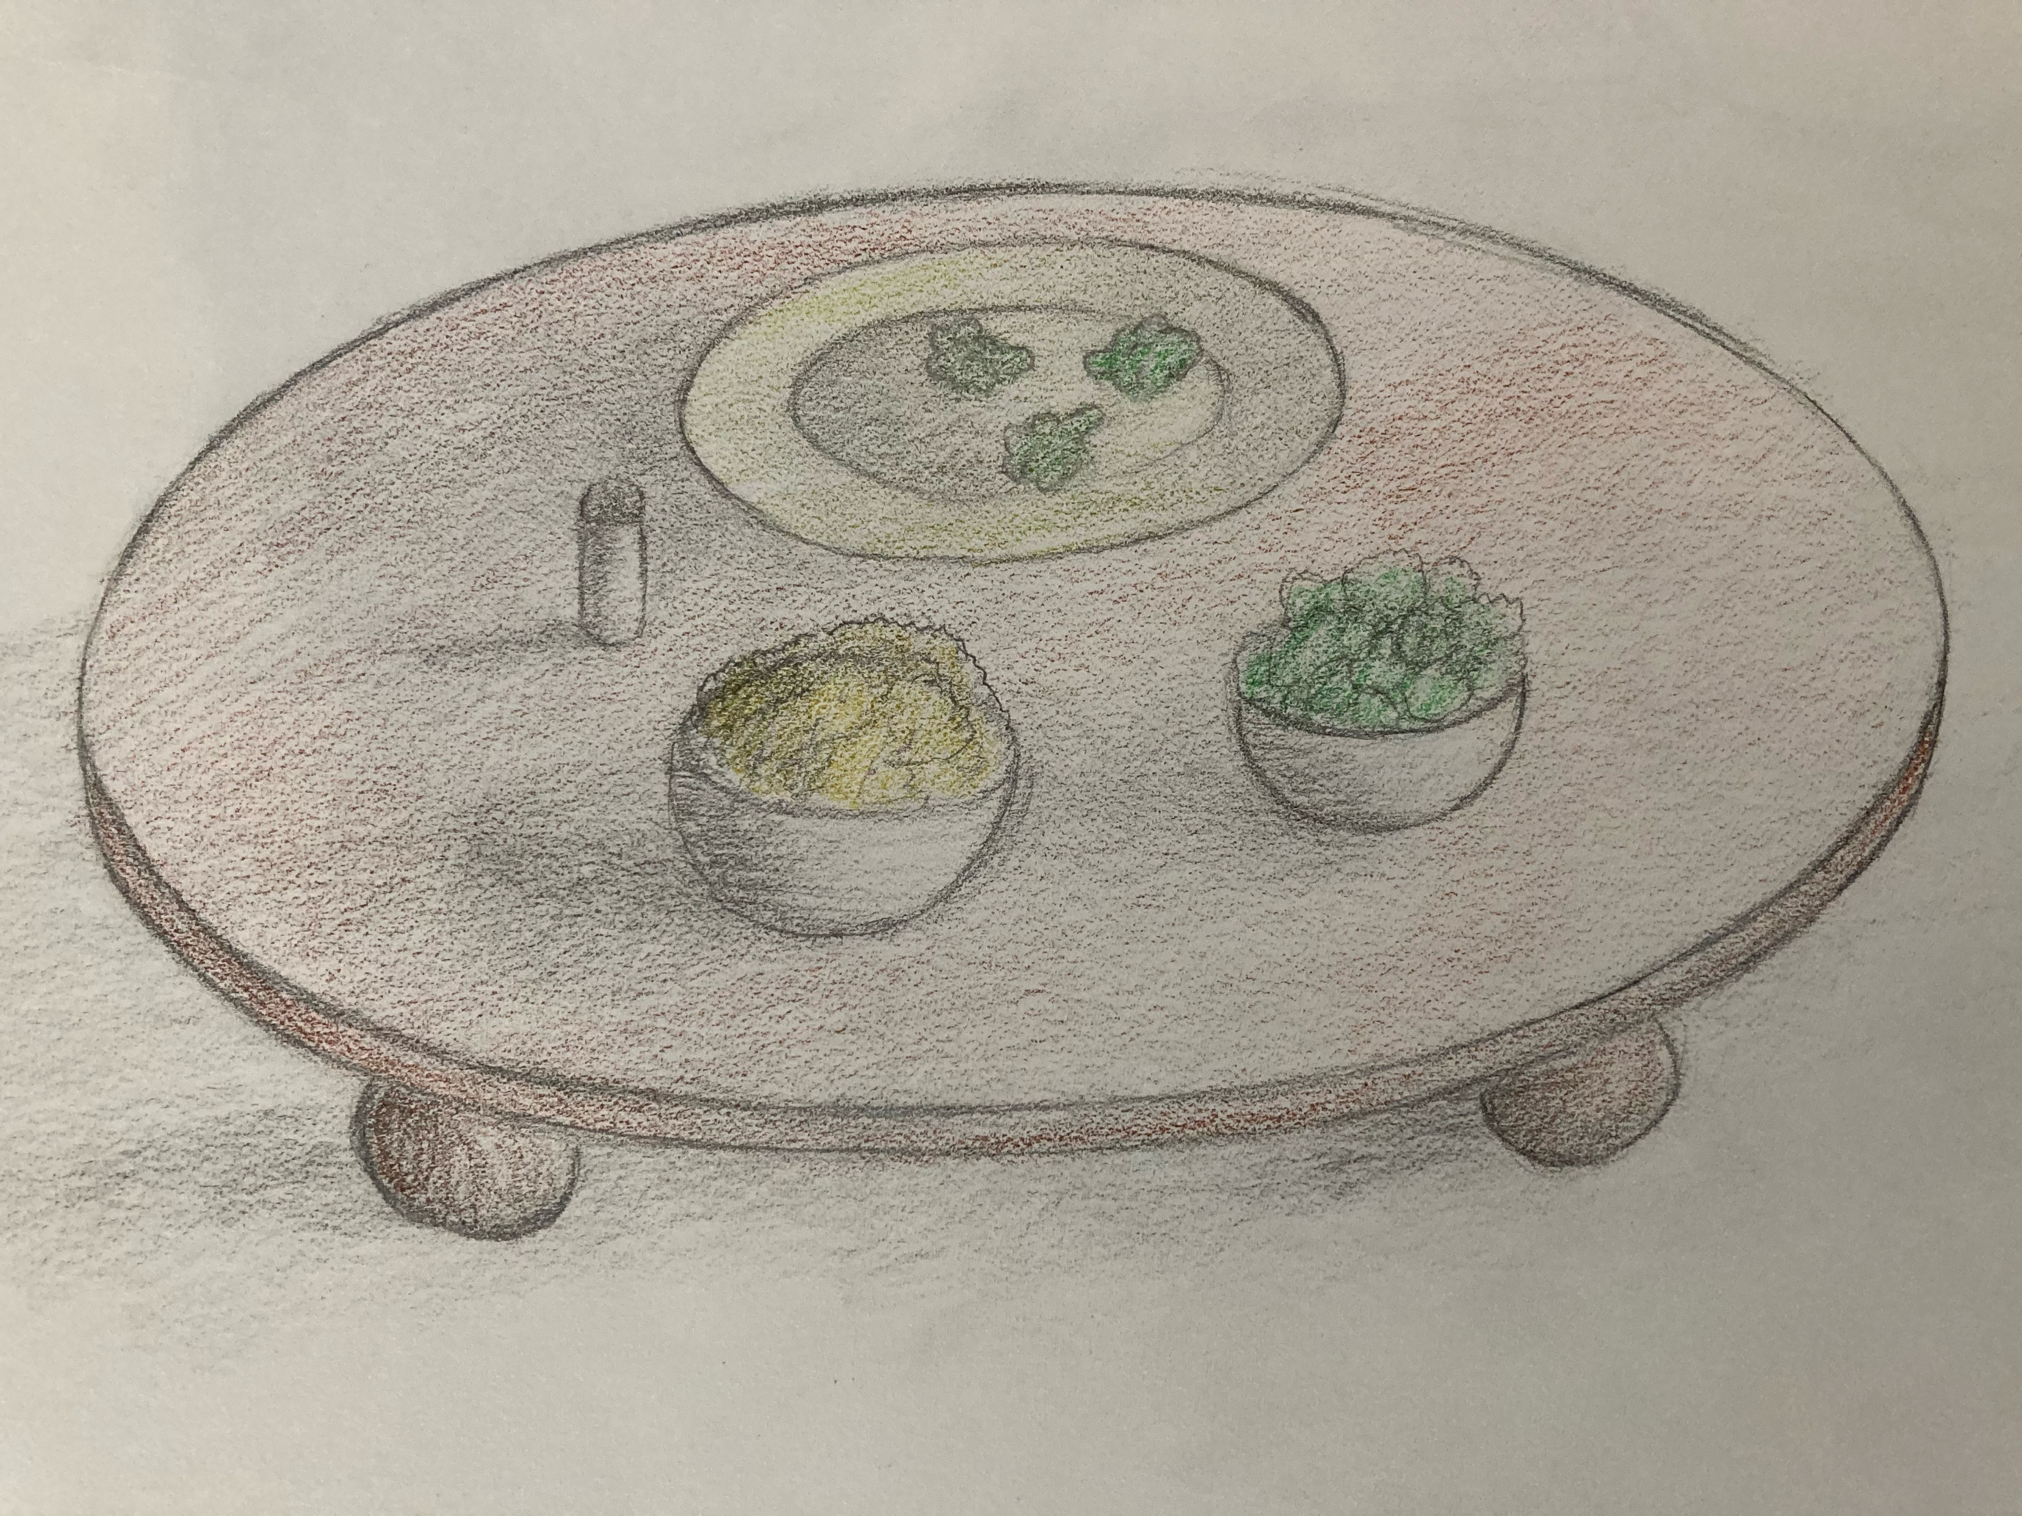
Daddy: What veggies do you like Websy?
Websy: Carrots and those long green things...
Daddy: Green beans?
Websy: Yeah!
Daddy: We can have green beans tomorrow, but tonight we have broccoli and we need to eat those too because they will make us big and strong.
Websy: Okay...

Slide 10
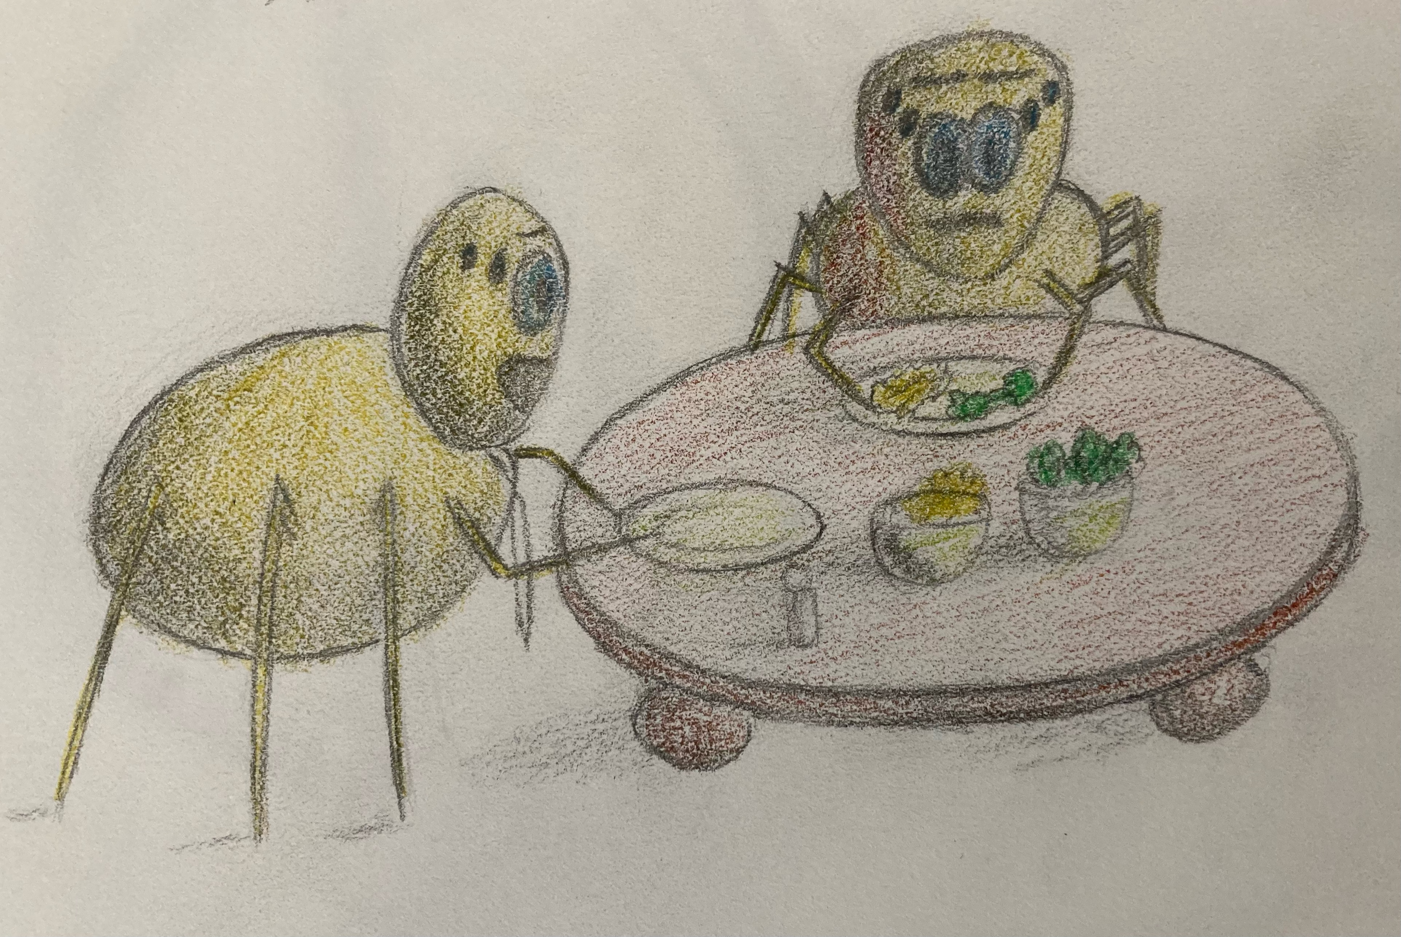
Daddy: You did such a good job eating your mac n' cheese earlier... can you take a big bite of that for me?

Slide 11
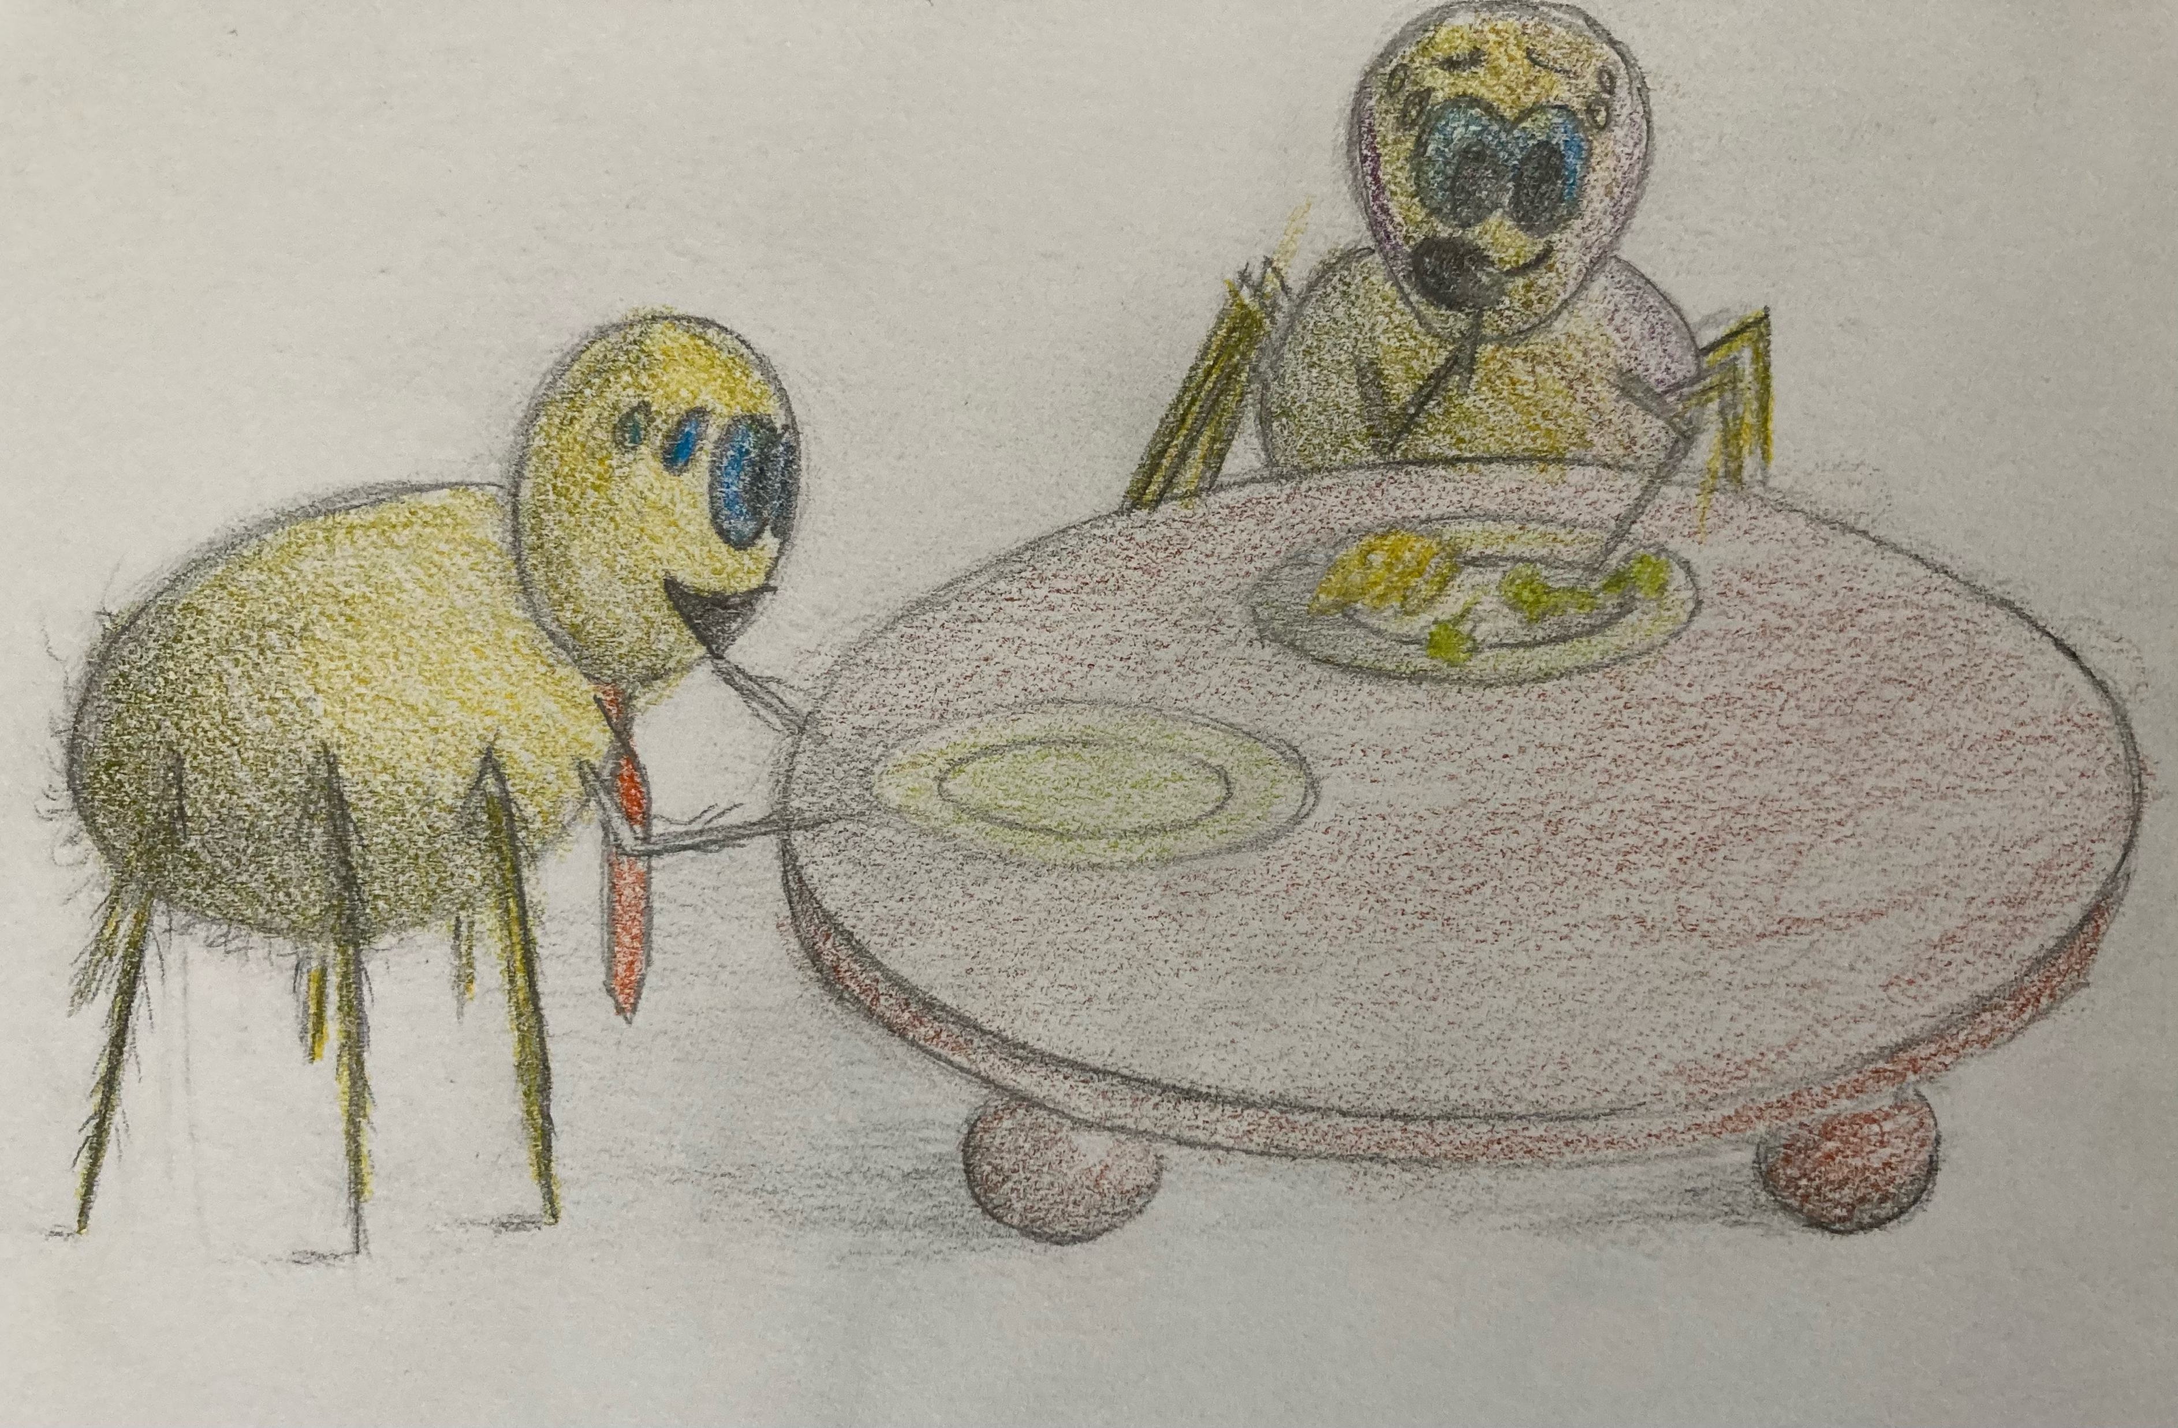
Good Job!
Websy
gobbles
down a bite of mac n' cheese

Slide 12
Now try a bite of your broccoli
Websy,
excited about playing with Daddy, takes a big bite of broccoli.

Slide 13
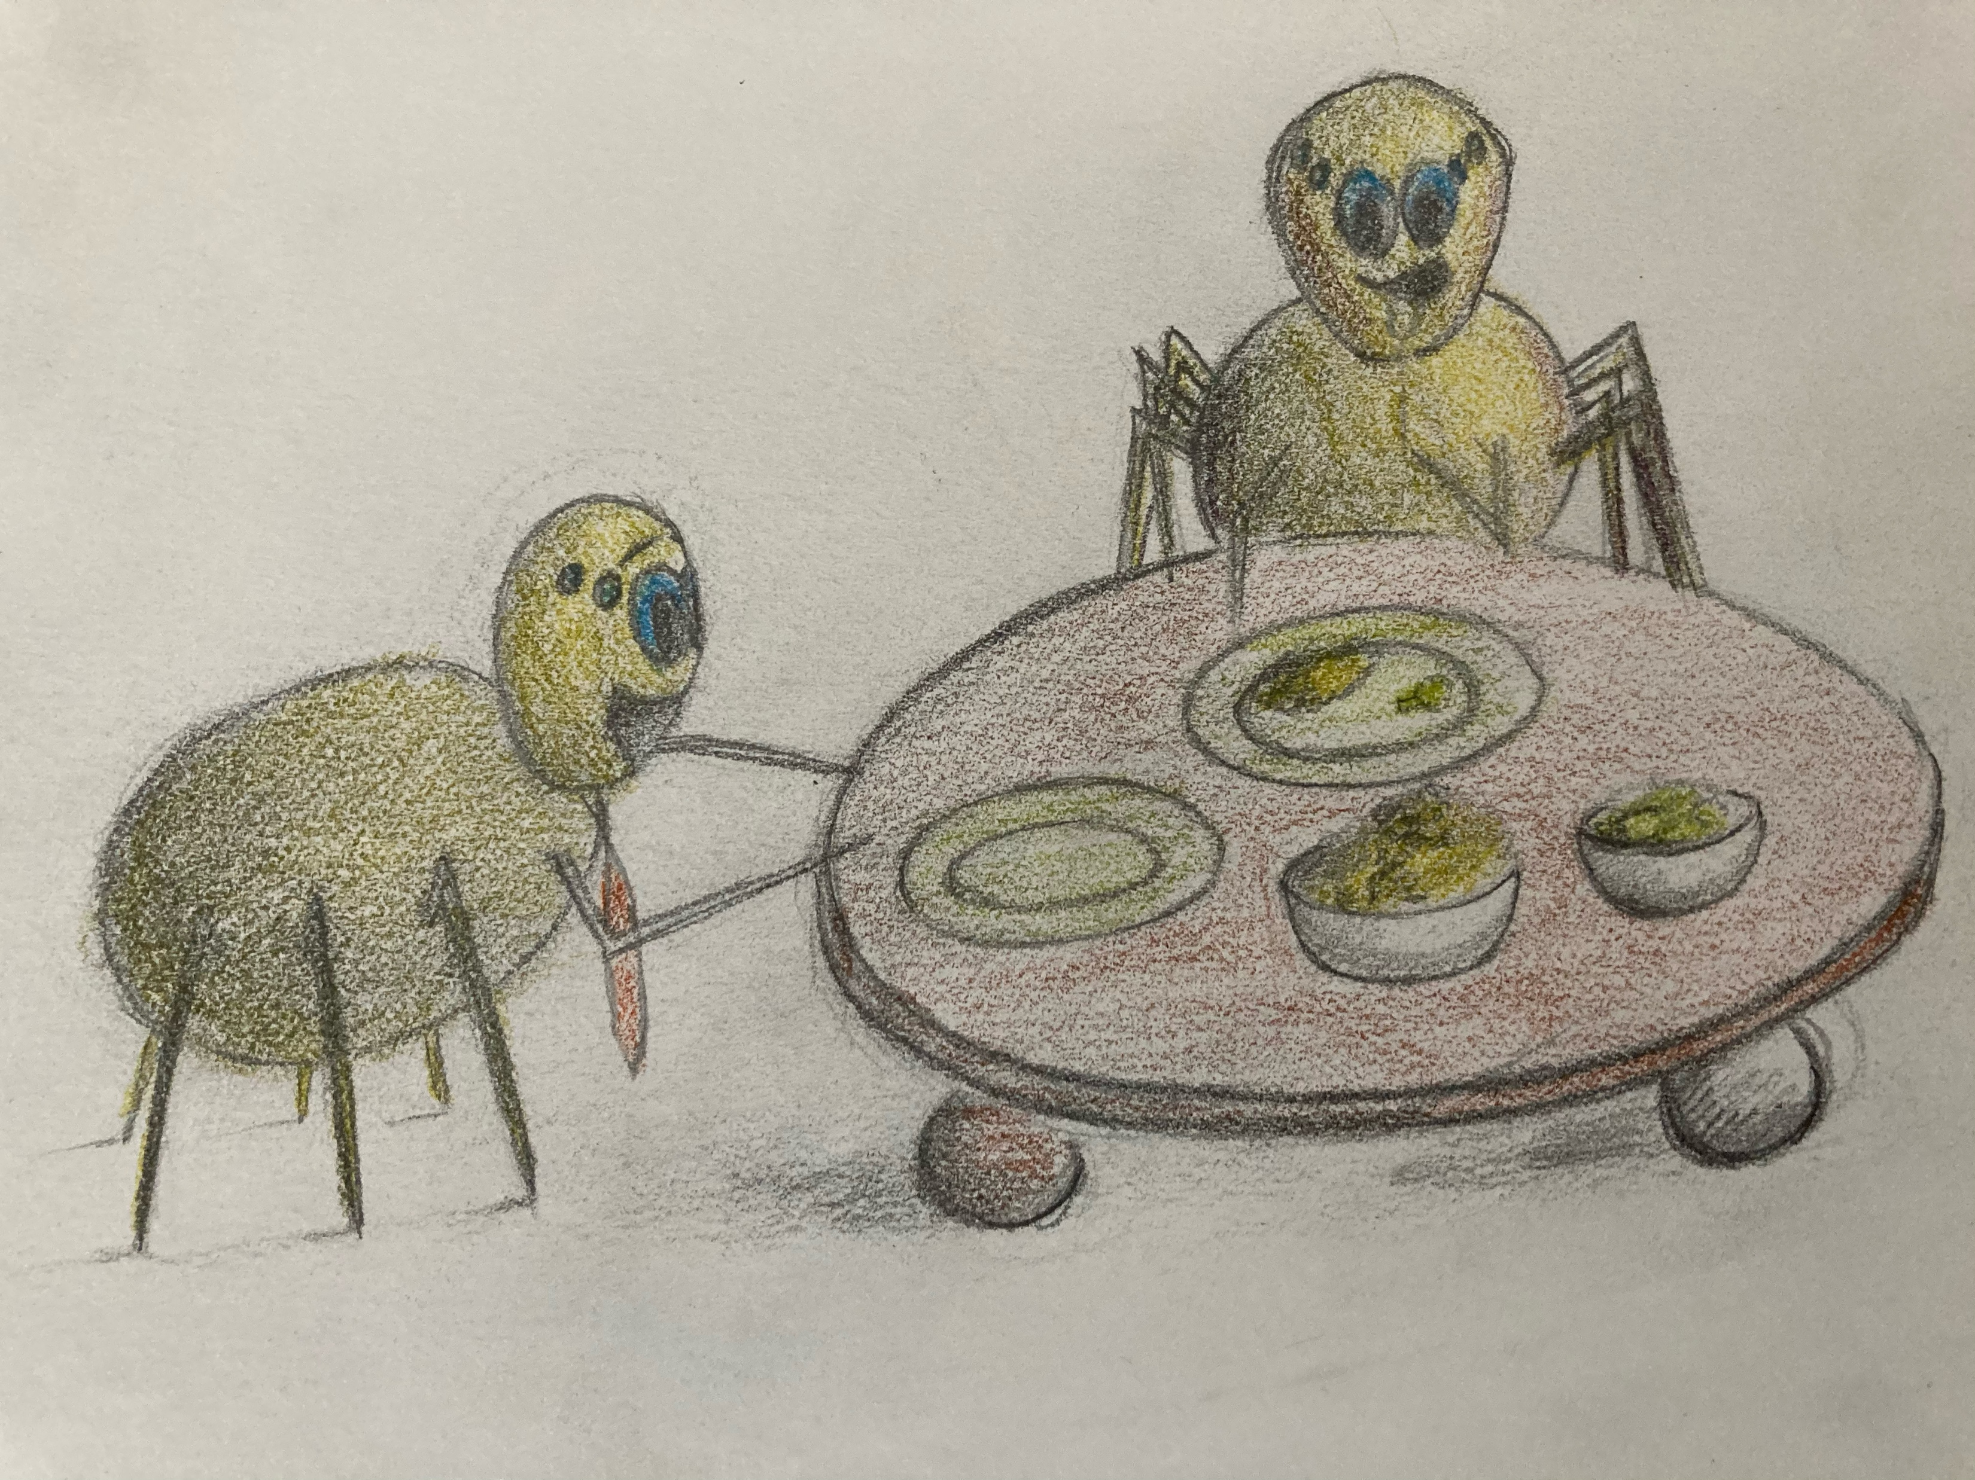
Daddy keeps asking Websy to take a bite of mac n' cheese, then a bite of broccoli and Websy finds this to be fun! Websy even starts to like the taste of the broccoli.

Slide 14
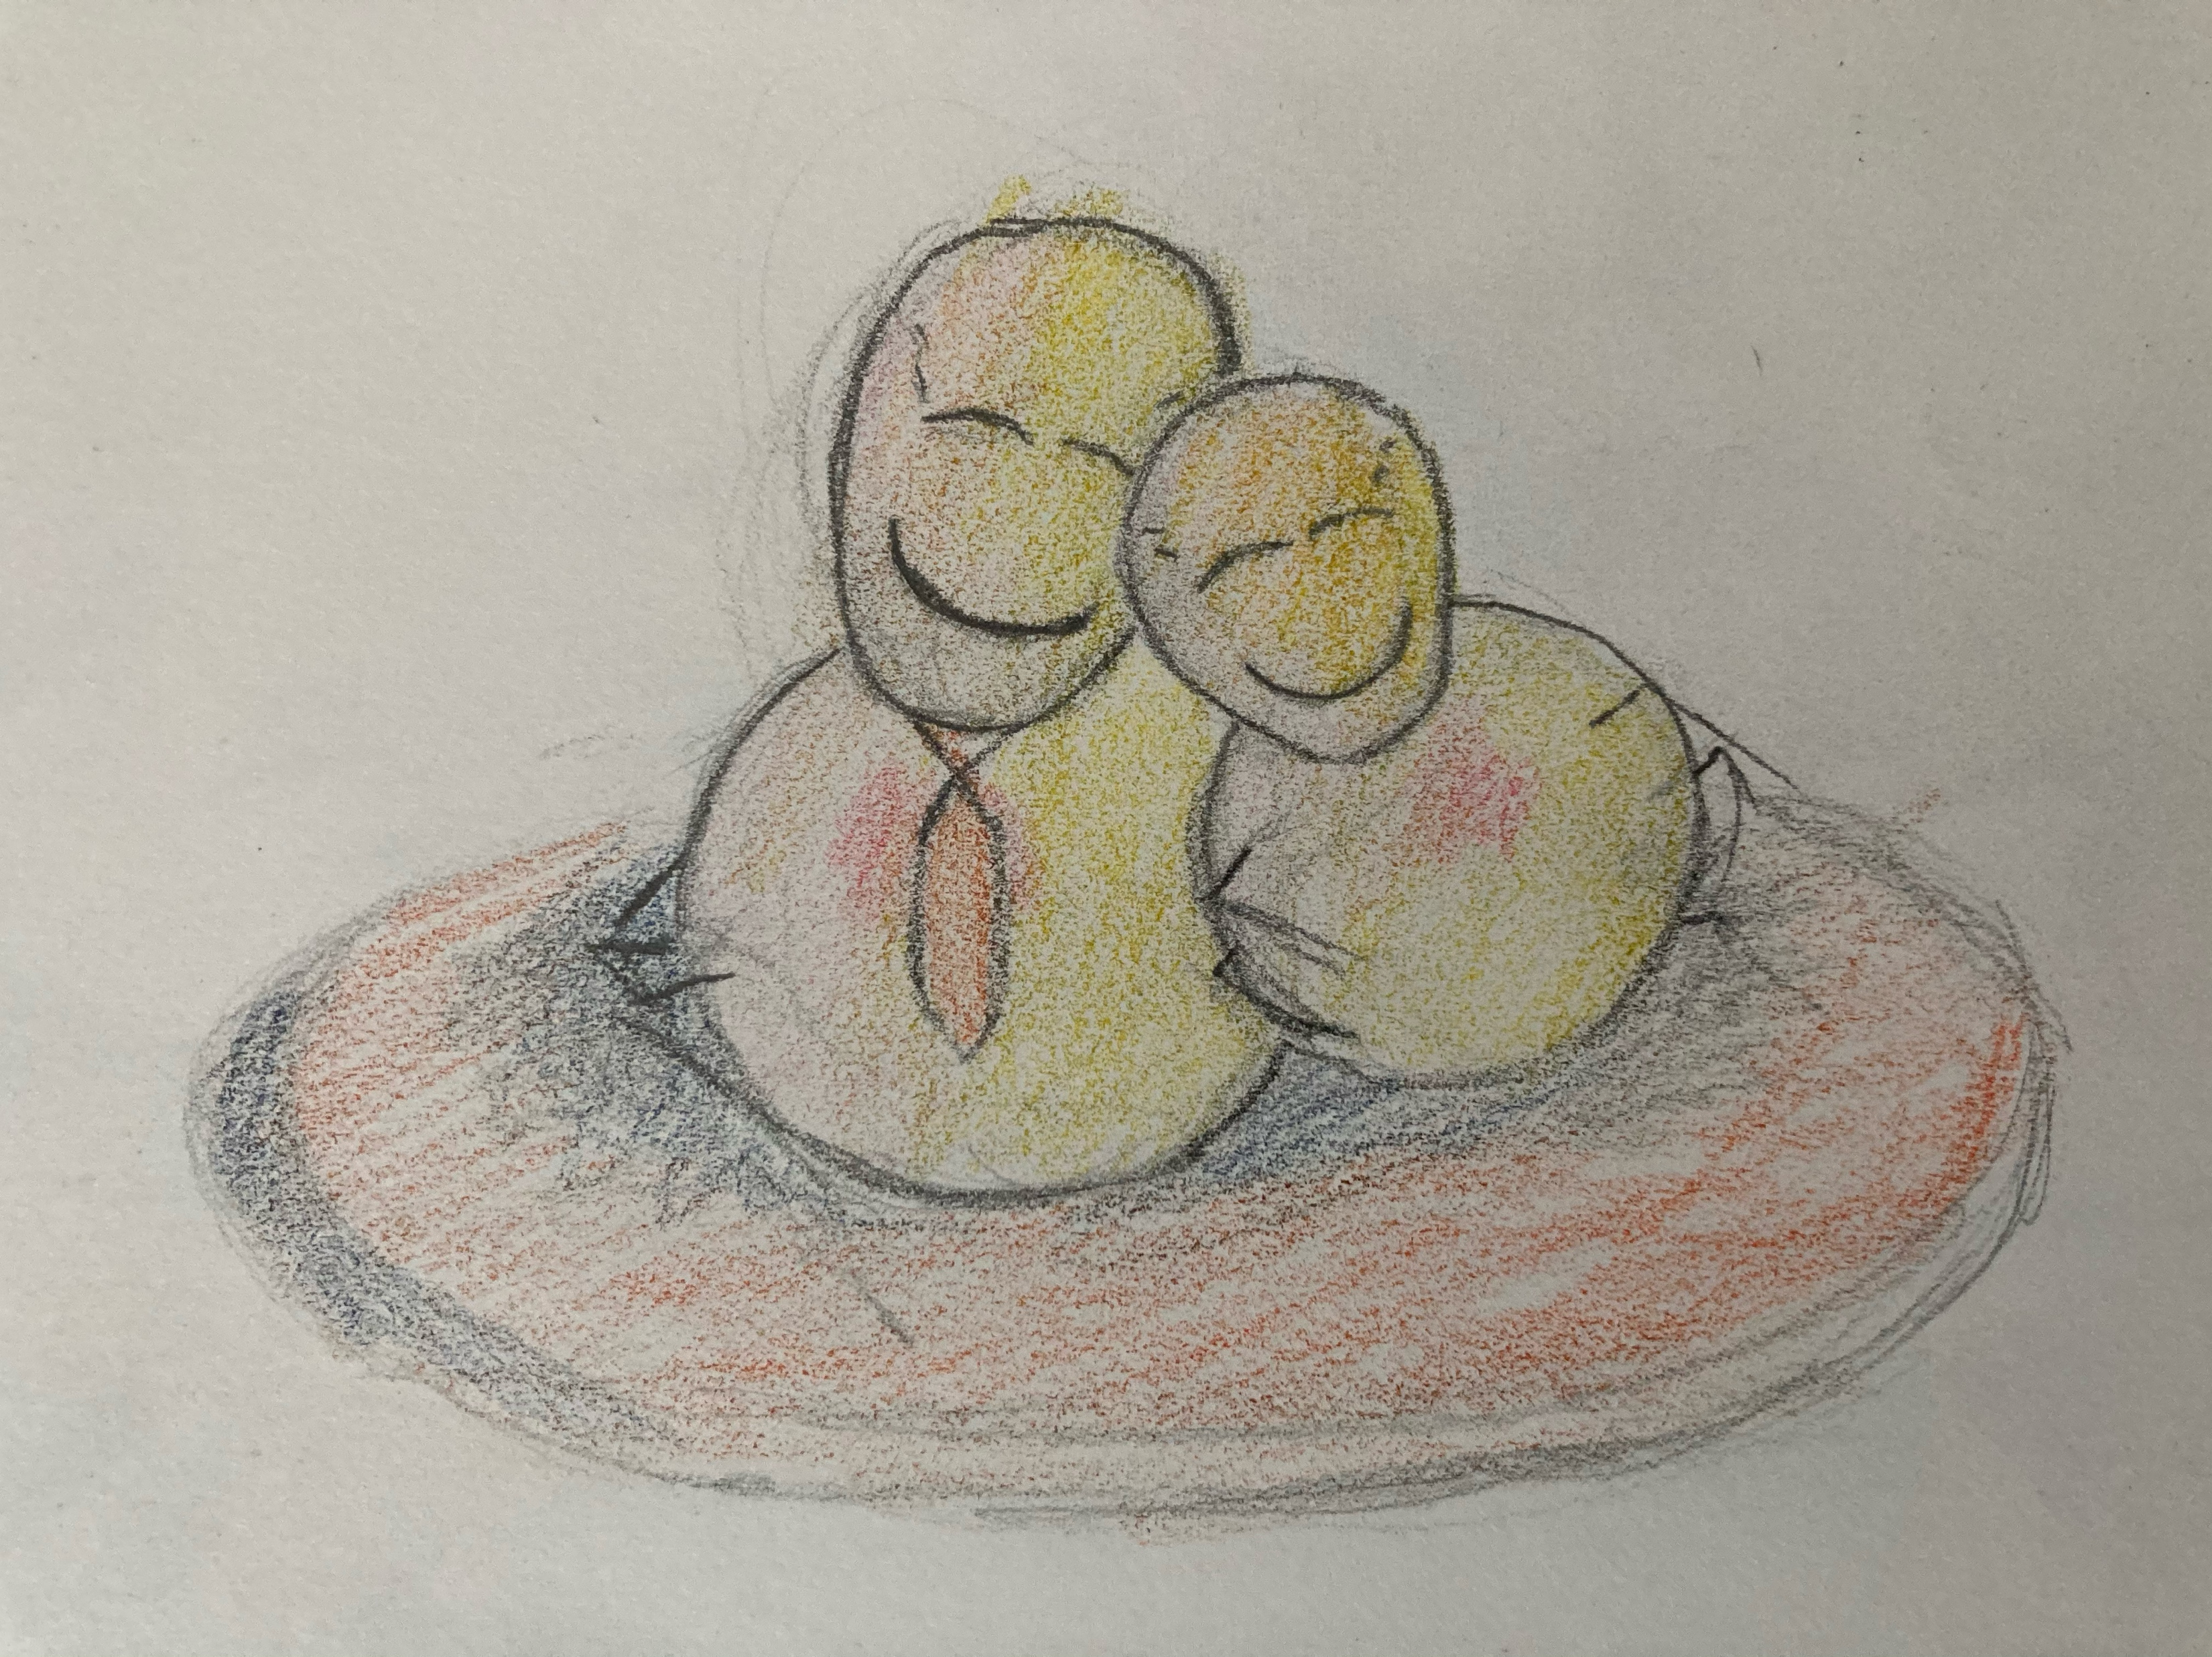
Daddy and Websy are full from a tasty meal and decide to cuddle up next to each other. They are both happy they were able to get past their anger. Daddy's not going to forget Websy's favorite veggies either. Tomorrow they will try those veggies. But Daddy will try out their eating game the next time Websy is eating broccoli.

Slide 15
Let's review!
Calm: We noticed both spiders getting frustrated. The parent spider took the time to calm down and then took the time to calm Websy down.
Ask: Next, we noticed the parent ask the child why they weren't eating their veggies. This led to understanding what veggies are Websy's favorite. This helps both the parent and child to understand what is going on.
Solve: The parent and child both think together, "How can we be healthy and enjoy it?" The Daddy thinks of a game format, alternating bites of food, and Websy enjoys this. Make sure to get your kids involved in solving the problem. It will teach them valuable life lessons.
Try: Websy starts alternating bites of food today and has a blast with it. The Daddy remembers what Websy's favorite veggies are, so that he can alternate days with the ones Websy likes.

